Slide 1
Purpofy
Winter Term 2021
Web Development
Laura Vogel
Markus Schürmann
Kristiyan Merdzhov
Gaetano Manzone

Slide 2
Agenda
Idea and Project Outline
Problems & Solutions
Progress Update
Next Steps and Goals

Slide 3
Idea and Project Outline
Purpofy
Find out your purpose and link up with likeminded people.
Who is our target customer?
A person who is feeling disoriented or unhappy with their life, specifically with regards to their career path.
What problem is our project intended to solve?
Purpofy wants to help people figure out what their true purpose is and give them a space to talk about their experience depending on which field they are working in.
Which type of content do we offer?
- Personality test
- Access to a community based on personality type and interests
- Videos and articles about self-development

Slide 4
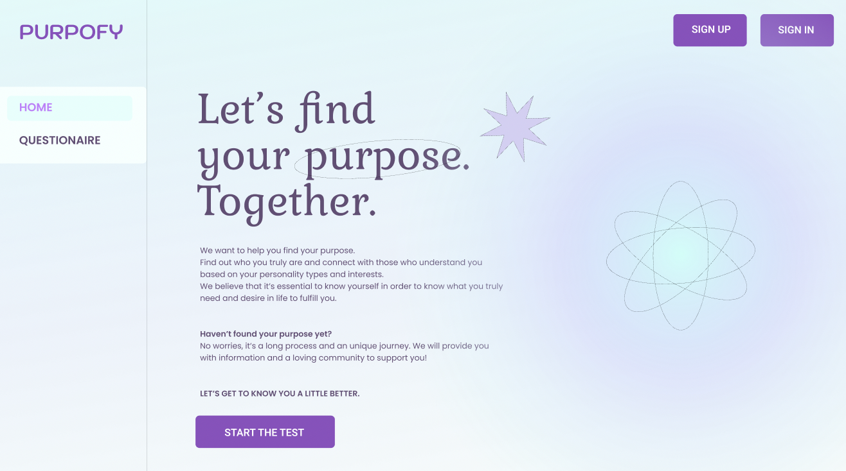
Idea and Project Outline
Start

Slide 5
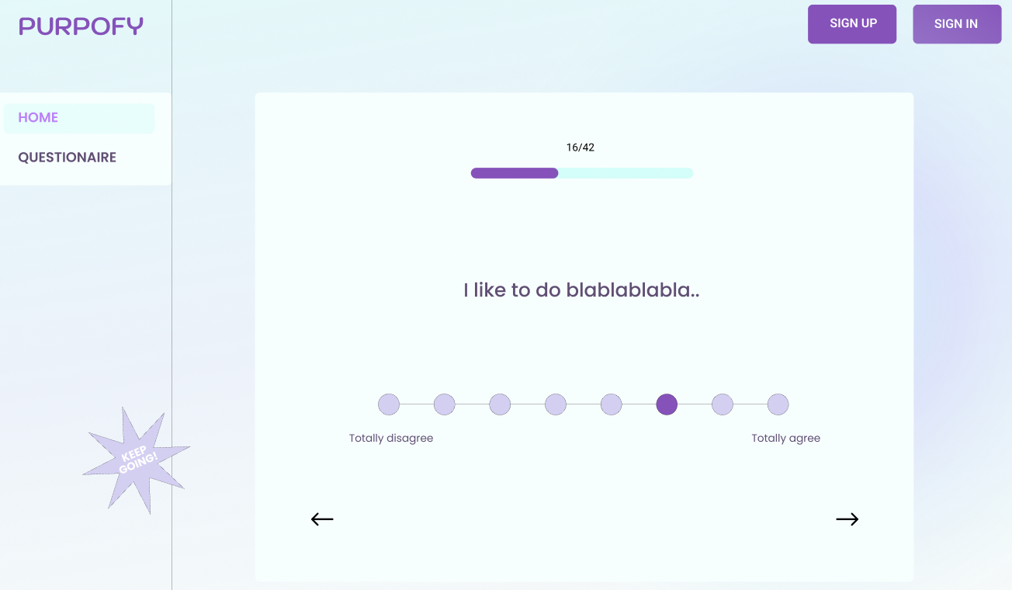
Idea and Project Outline
Questionnaire
Inspo: 16 Personalities Test.

Slide 6
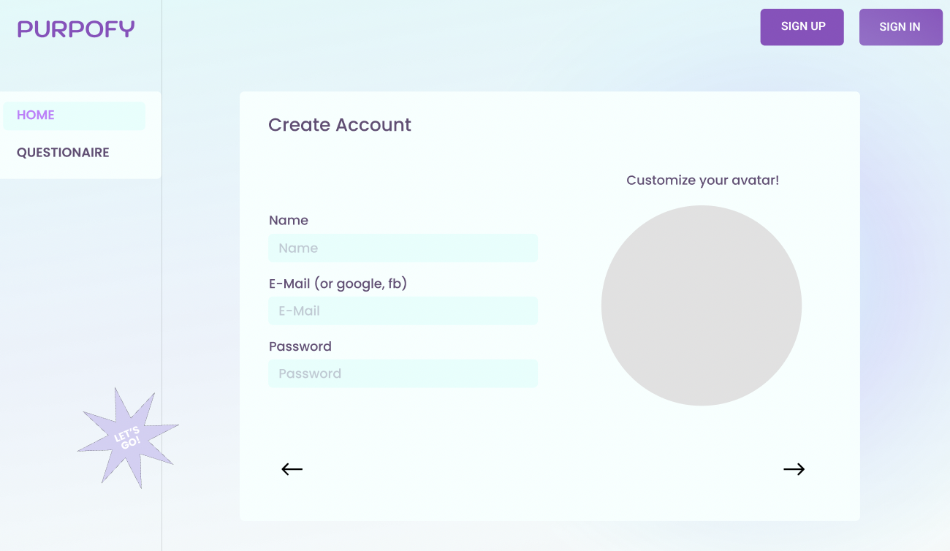
Idea and Project Outline
Create account

Slide 7
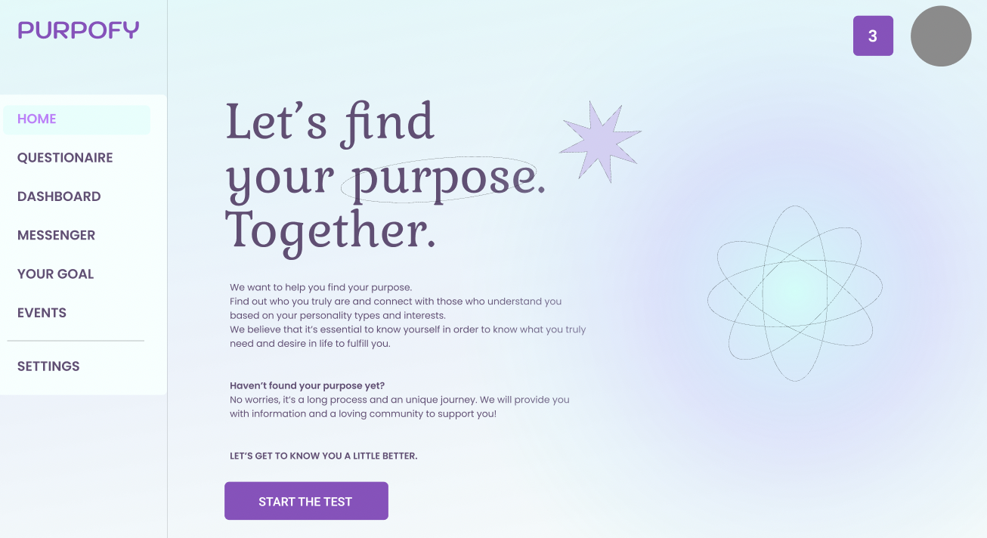
Idea and Project Outline
Start as a logged-in user

Slide 8
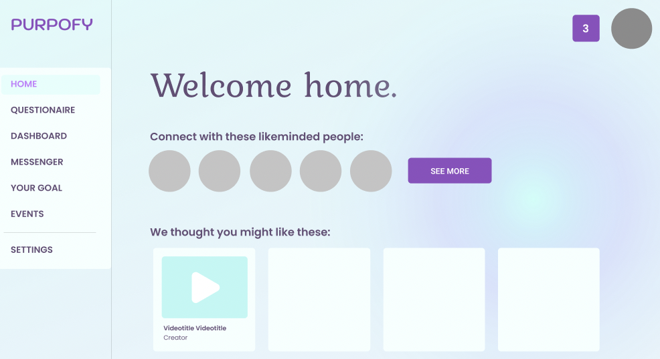
Idea and Project Outline
Dashboard

Slide 9
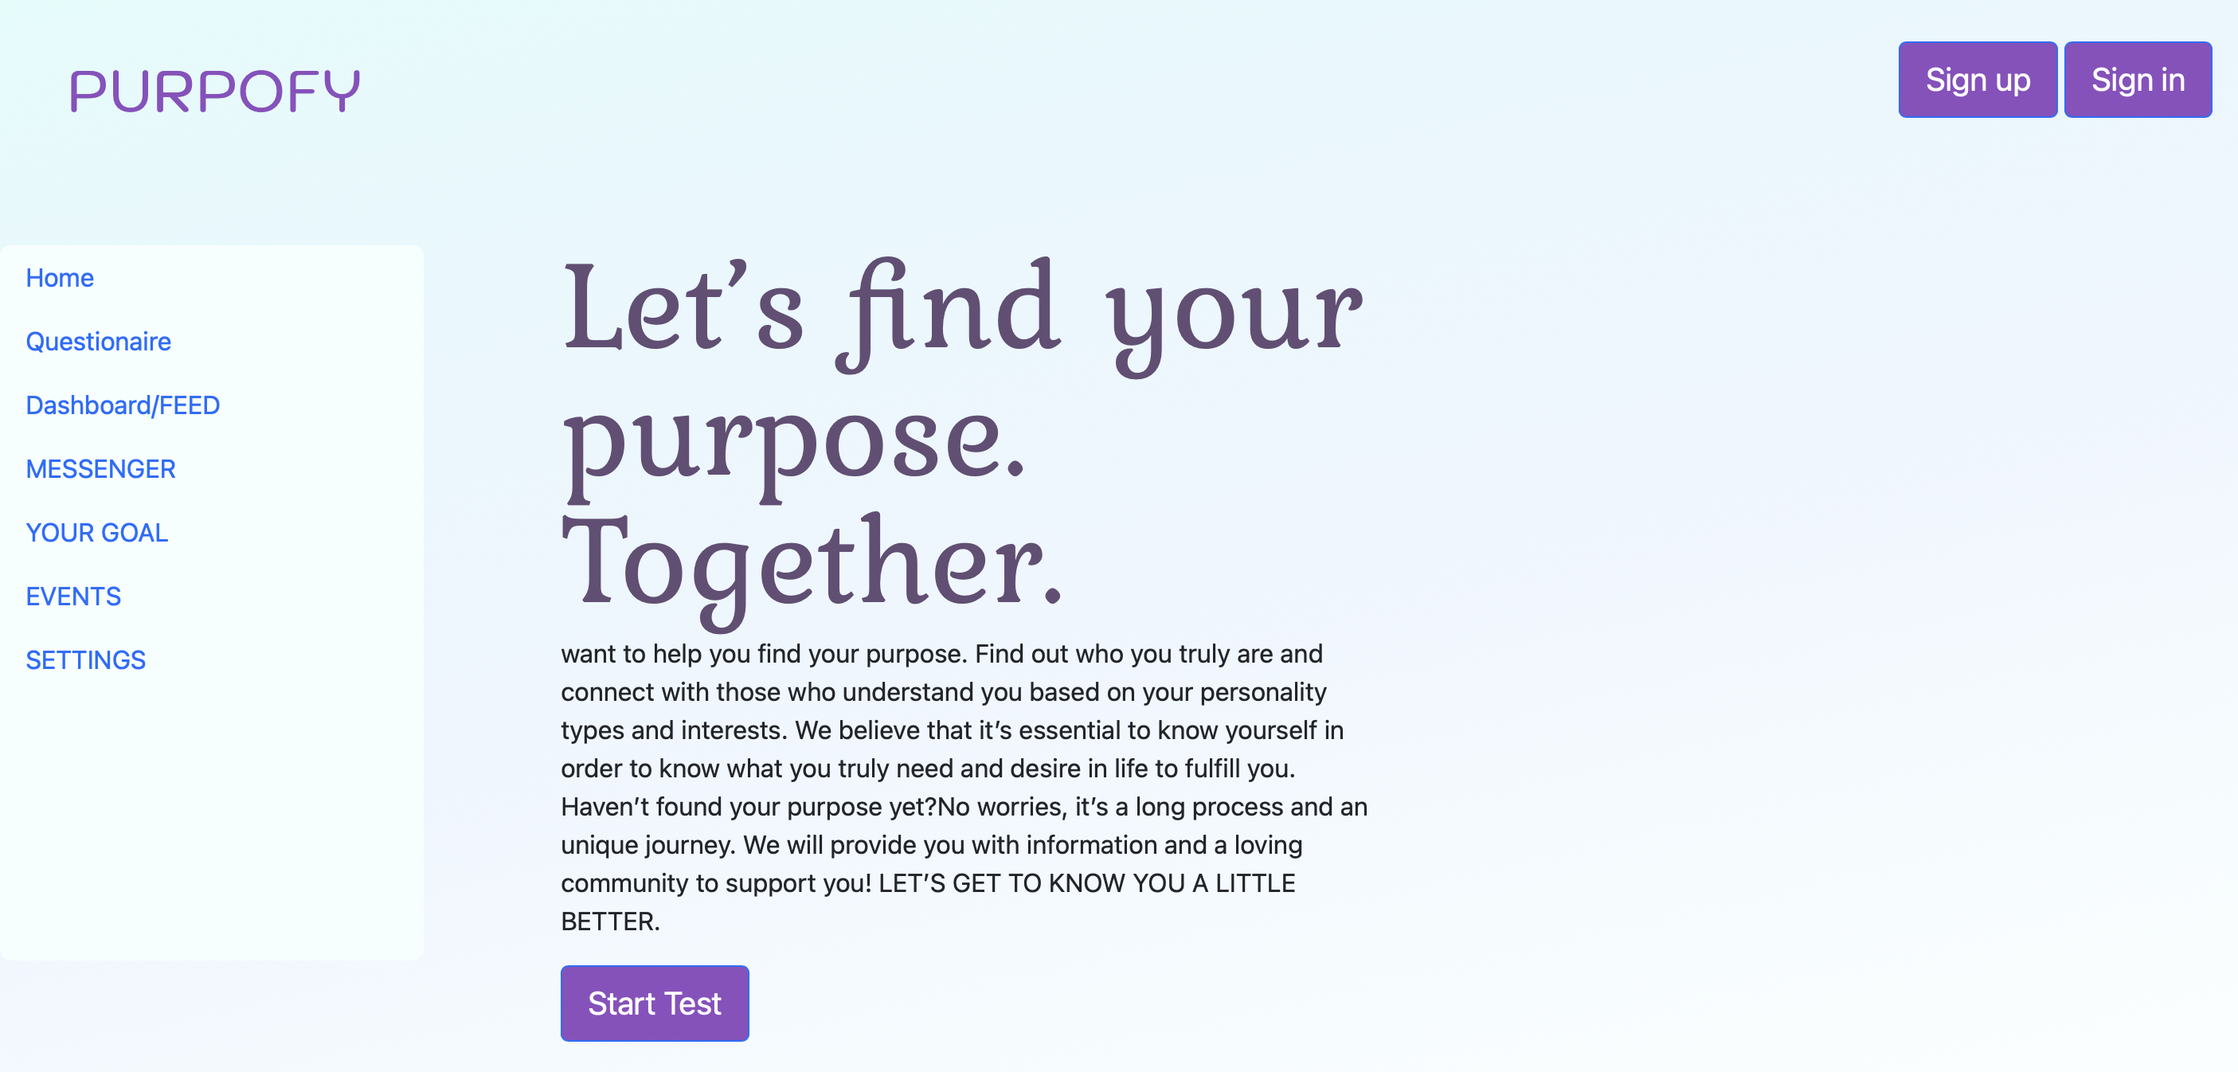
Progress Update
Start

Slide 10
Problems and Solutions
Purpofy
Find out your purpose and link up with likeminded people.
Tools:
node.js (JavaScript runtime environment) MongoDB (Database)
BootStrap (Frontend)
Flexbox (Frontend) JQuery (Frontend)
Visual Studio Code (IDE)
Figma
Git + Github
Mongoose (Connection between express.js and MongoDB)
Cloud Hosting (To be decided)

Slide 11
Next Steps and Goals
Purpofy
Find out your purpose and link up with likeminded people.
What’s next?
- Navigation (Structure)
- Backend
- Set up a database - Put together the questionnaire

Slide 12
THANK YOU FOR YOUR ATTENTION :)

Slide 13
Purpofy
Winter Term 2021
Web Development
Laura Vogel
Markus Schürmann
Kristiyan Merdzhov
Gaetano Manzone

